Slide 1

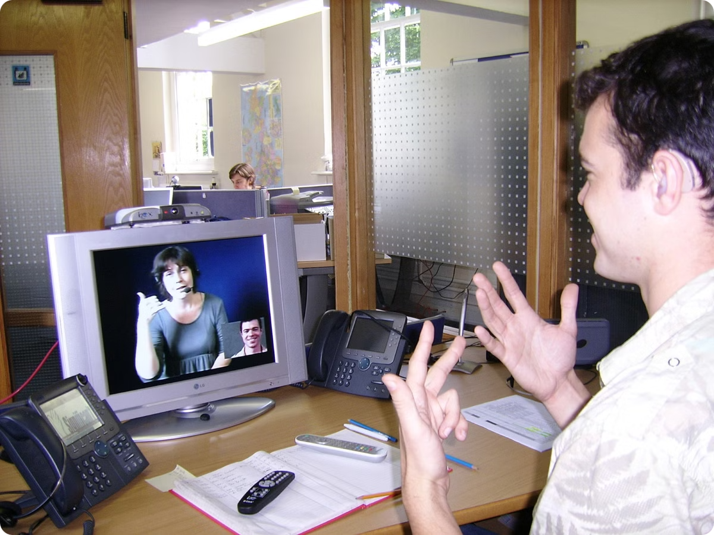
Real-Time Sign Language Communication System
This presentation delves into the advancements in sign language translation, showcasing the transformative potential of technology in fostering inclusivity and breaking communication barriers. It highlights the key challenges faced in this field, such as linguistic complexity and real-time processing, while uncovering the vast opportunities to empower millions of deaf and hard-of-hearing individuals. With a focus on innovative solutions and future possibilities, this exploration underscores the critical role of sign language translation in creating a more accessible and connected world.
by Priyanshu Walia, Mayank Chopra

Slide 2

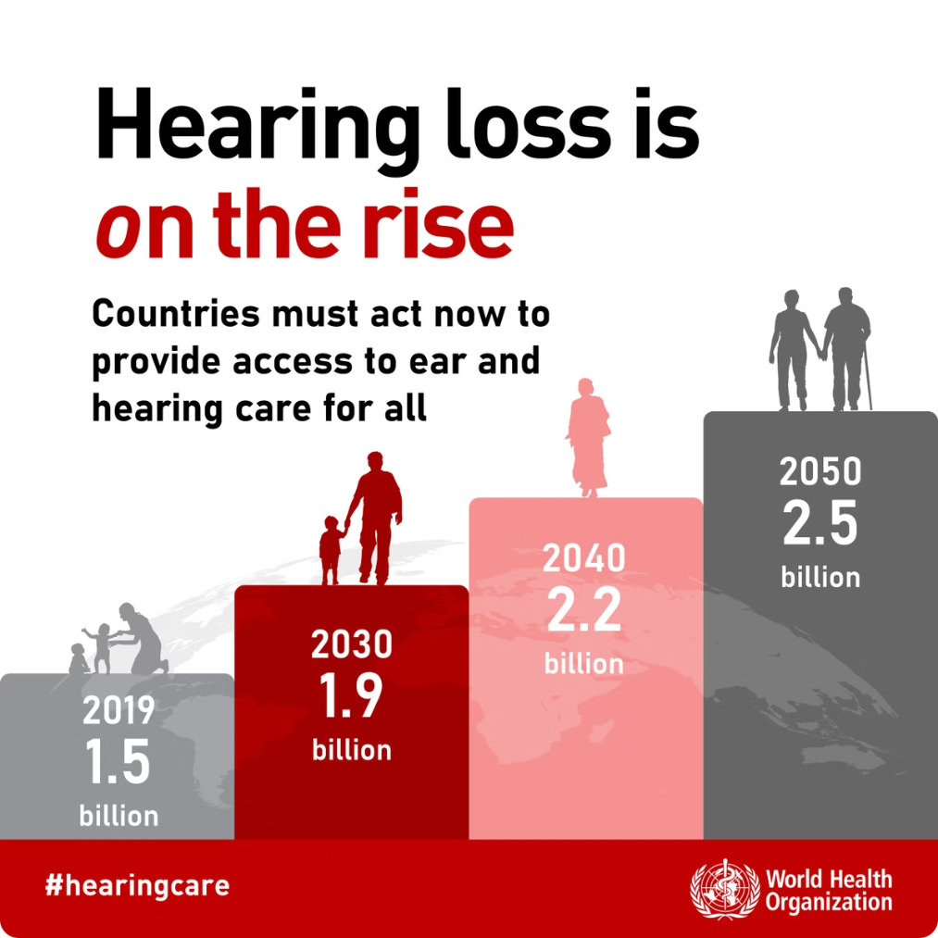
What Is the Problem?
1
Communication Barrier
2
Limited Access to Information and Services
Millions worldwide rely on sign language, encompassing diverse regional variations and intricate grammatical structures. This reliance highlights a significant communication gap affecting many areas of life.
Deaf and hard-of-hearing individuals face significant barriers accessing vital information, services, and equal opportunities in education, employment, and healthcare, perpetuating inequalities.
3
The Cost of Inaccessibility
Communication barriers lead to societal challenges like higher unemployment, reduced educational attainment, and limited healthcare access for deaf and hard-of-hearing individuals. Addressing this offers substantial economic and social benefits.

Slide 3

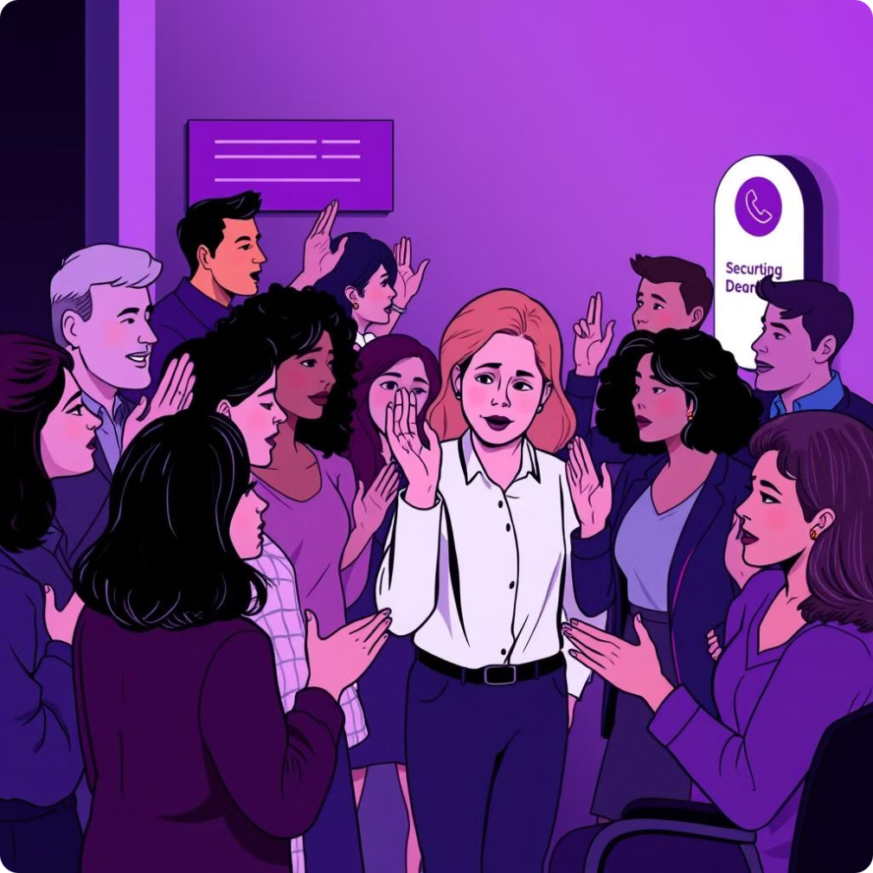
Our Mission
We aim to revolutionize communication accessibility by developing a real-time system that translates sign language gestures into text and speech and vice-versa. Which integrates technologies like deep learning, computer vision, and natural language processing (NLP) to deliver accurate and efficient translations.
In India, approximately 63 million people, or 6.3% of the population, are deaf or hard of hearing. Despite this significant number, the community faces numerous challenges. Nearly 99% of deaf individuals with significant hearing loss receive little to no formal education, 73.9% are unemployed or marginally employed. While Indian Sign Language (ISL) has evolved over the years, it was only codified in a dictionary format in 2017. Our project seeks to address these systemic barriers, enhancing communication and enabling greater opportunities for this underserved population.

Slide 4
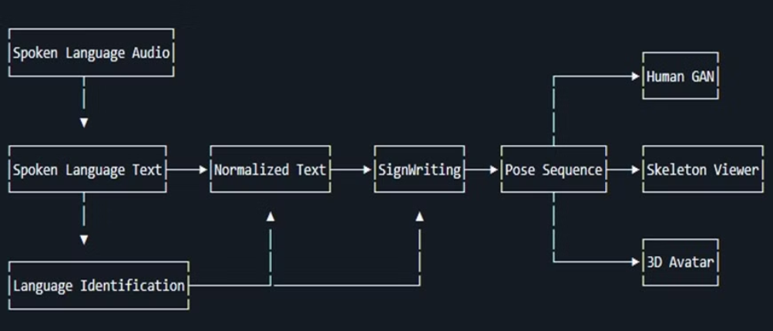
Why This System Is Unique
Real-Time Processing
Tech Stack
Our system boasts impressive real-time performance, with a latency of only 120ms, enabling seamless communication and natural, engaging interactions.
We leverage cutting-edge technologies: convolutional neural networks (CNNs), recurrent neural networks (RNNs), and MediaPipe, along with OpenCV for image processing and Flask/JS for UI, ensuring accurate and robust translation.
Multimodal Output
Scalability and Diversity
For comprehensive communication, our system generates both text and speech translations, catering to diverse user preferences and accessibility needs.
Our scalable architecture supports various sign languages, promoting global inclusivity and adaptability to diverse communities.

Slide 5
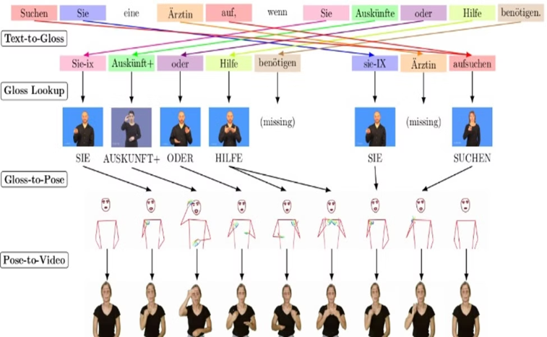
How It Works
1. Data Preprocessing
3. User Interface Integration
Sign language data is prepared for analysis. Video normalization, frame segmentation, and landmark extraction are key steps.
A Python Flask backend manages data processing. A React.js frontend allows user interaction. AWS deployment ensures scalability.
1
2
3
2. Deep Learning Models
CNNs analyze spatial hand gestures, while RNNs process temporal sequences. Models are trained on large datasets.

Slide 6
Data at a Glance
How2Sign Dataset
Data Split
The How2Sign dataset comprises a vast collection of sign language videos, encompassing over 13.5 million frames with size of 290 GB
The dataset is meticulously divided for model training, validation, and testing.
The training set encompasses 80% of the data, while validation and testing sets each account for 10%.
These videos provide rich visual information for training models, including depth information, hand landmarks, and corresponding translations.

Slide 7
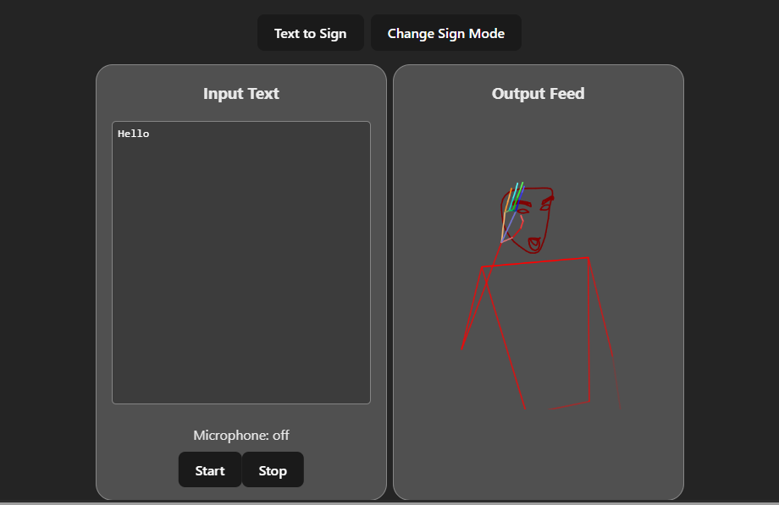
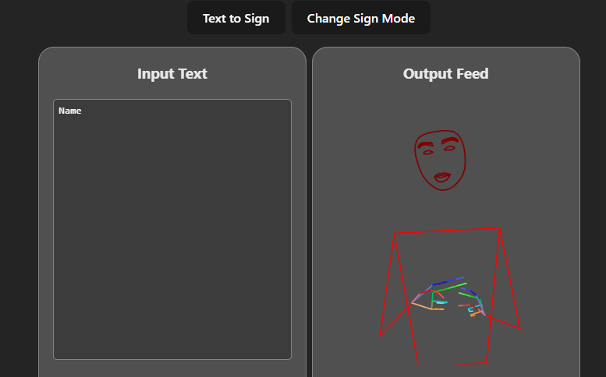
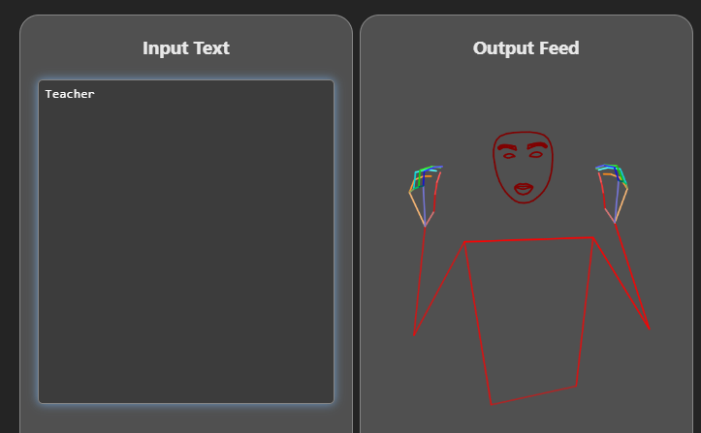
Performance Metrics
High Accuracy and Precision
Low Word Error Rate
Real-Time Performance
Our model demonstrates consistently high accuracy, precision, and recall, indicating its ability to correctly identify sign language gestures.
The Word Error Rate (WER) is relatively low, showcasing the model's proficiency in accurately transcribing sign language into text or speech.
The model achieves a high frames per second (FPS) rate with minimal latency, enabling seamless real-time translation of sign language.

Slide 8
How We Stand Out
System
Accuracy (%)
FPS
Latency (ms)
Proposed System
92.5
25
120
DeepSign
89.2
20
150
SignAll
88.5
22
160
The proposed system demonstrates superior performance in accuracy, frames per second, and latency compared to existing solutions.
These key metrics translate into a smoother, more responsive, and accurate sign language translation experience.

Slide 9
Looking Ahead
Challenges
Future Work
Handling regional gesture variations: Sign language can vary significantly across different regions, even within the same language. For example, the sign for "thank you" differ subtly between the UK and US.
Enhance contextual understanding with transformers: Leveraging transformer-based models can help capture the context and nuances of sign language, leading to more accurate and natural translations.
Reducing translation errors for complex gestures: Some signs incorporate multiple hand shapes, movements, and facial expressions.
Expand to support more sign languages: Currently, many sign language translation systems focus on a limited number of languages. Expanding support to encompass a wider variety of sign languages is essential for global accessibility.
Ensuring real-time performance: For practical applications like video conferencing, real-time translation is crucial. Achieving low latency while maintaining accuracy is an ongoing challenge.
Integrate AR/VR for immersive learning: Augmented and virtual reality technologies can offer immersive and interactive learning experiences for sign language acquisition and practice.

Slide 10

Conclusion
Real-time sign language translation fosters greater understanding and accessibility for the Deaf and hard-of-hearing communities.
This technology empowers individuals to fully participate in various aspects of life, from education and employment to social interactions and healthcare.
By bridging the communication gap, we can create a more inclusive world where everyone feels valued and heard.
Let's work together to create a more inclusive world through innovative technology and accessibility solutions.

